Slide 1

Controllers – Part 1

Slide 2
Agenda
Controller - Definition and Usage
Role played by controller in MVC
Action
Scaffolding - Static and Dynamic
Rendering Views And Models - Basic
Redirecting And Forwards
Controller Scopes – Params ,session, flash scope
Interceptor

Slide 3
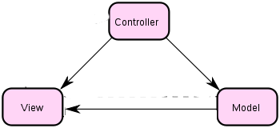
What is a Controller?
Controllers are responsible for handling requests coming into the application
Generate the response or delegate to a view
Execute another controller action
Controller updates view
Controller updates model
Model notifies view of changes
Notes:
A set of services, APIs and protocols. Multi Tiered web applications.
A Standardized way of doing things. Decreases the need for programming a lot of features which are already available as re-usable components.

Slide 4
Defining a Controller
A class defined under grails-app/controllers directory
Name ends with Controller as a convention; appended to end of controller name by default
grails create-controller sample
Are request-scoped, i.e. a new instance is created for every request
Notes:
A set of services, APIs and protocols. Multi Tiered web applications.
A Standardized way of doing things. Decreases the need for programming a lot of features which are already available as re-usable components.

Slide 5
Actions
Actions are groovy closures, each of these actions maps to a URI
def myFirstAction() {
  render “Sample controller Accessed”
}
Every controller has a number of actions; the above example maps to <....>/sample/myFirstAction
(SampleController is the name of the controller)
Notes:
A set of services, APIs and protocols. Multi Tiered web applications.
A Standardized way of doing things. Decreases the need for programming a lot of features which are already available as re-usable components.

Slide 6
Scaffolding
Grails allows you to use dynamically generated code to get you started
Set the property 'scaffold' of a controller to true to generate code on the fly
def scaffold = true
  def scaffold = Author // Author is a domain class
Views generated are HTML5 compliant since Grails 2.0.0

Slide 7
Scaffolding Types
Dynamic Scaffolding
def scaffold=Author
Static Scaffolding
grails generate-all Author
It will generate all the artifacts like AuthorController, show.gsp,edit.gsp.. etc

Slide 8
Demo

Slide 9
Actions : Setting Default
There are 3 ways to define the default action of a controller
Create an action named index
def index () {
  render “The action is right here – at index”
}
Define a property named defaultAction
static defaultAction = “myFirstAction”
def myFirstAction() {
  render ”WooHoo!!”
  }
Notes:
A set of services, APIs and protocols. Multi Tiered web applications.
A Standardized way of doing things. Decreases the need for programming a lot of features which are already available as re-usable components.

Slide 10
Actions : Setting Default
Create a single action in the controller
def theOnlyAction() {
  render “Nobody else here but me!”
  }
Notes:
A set of services, APIs and protocols. Multi Tiered web applications.
A Standardized way of doing things. Decreases the need for programming a lot of features which are already available as re-usable components.

Slide 11
Restricting Access to Actions
By default all controller actions are accessible using any HTTP request method (GET, PUT, POST, etc...).
request.getMethod()
To restrict this, define a map by the name of allowedMethods
Every key of this map specifies the action name and the value of a key specifies the request method that the action should be allowed
static allowedMethods = [action1: 'POST',
action2: ['POST', 'GET', 'DELETE']]

Slide 12
Rendering the View
Based on convention, a gsp by the same name as the action is searched for, if no view is specified explicitly
def myFirstAction = {}
When trying to access this action, a view with the name of myFirstAction.gsp will be searched. If not found, it will give a 404 error
To render a custom view, use the render method.
render(view:"display")
Notes:
A set of services, APIs and protocols. Multi Tiered web applications.
A Standardized way of doing things. Decreases the need for programming a lot of features which are already available as re-usable components.

Slide 13
Creating a Model
A key duty of the controller is gathering data that will be rendered in the view
The collected data is put in a map called model
class SampleController {
def show = {
render(view: 'show', model: [song: Song.get(1) ]
}
}
Notes:
A set of services, APIs and protocols. Multi Tiered web applications.
A Standardized way of doing things. Decreases the need for programming a lot of features which are already available as re-usable components.

Slide 14
Demo

Slide 15
Redirecting a request
Passing control to another action within or outside the same controller
Redirect method accepts a map as an argument
redirect(controller: 'sample', action: 'first')
Arguments : action, controller, id, params, uri, url
Difference b/w redirect and forward
Notes:
A set of services, APIs and protocols. Multi Tiered web applications.
A Standardized way of doing things. Decreases the need for programming a lot of features which are already available as re-usable components.

Slide 16
Redirect and Forward
Forward:
Is performed internally by the servlet
Original URL stays intact
Redirect
Two step process - web application instructs the browser to fetch a second URL, which differs from the original
Slower than a forward, since it requires a
second browser request

Slide 17
Some Examples
forward action: "show", id: 4, params: [author: "Stephen King"]
forward (controller: "book", action: "show")
redirect(action:login)
redirect(controller:'home',action:'index')
redirect(uri:"/login.html")
redirect(url:"http://grails.org")
redirect(action:myaction,params:["myparam":"myvalue"])

Slide 18
Controller Scopes
servletContext : allows us to share state across the entire web application.
session : allows associating state with a given user.
request : allows the storage of objects for the current request only.
params - map of incoming request parameters
flash : Objects placed in this scope are kept for the duration on the current request and the next request
Notes:
A set of services, APIs and protocols. Multi Tiered web applications.
A Standardized way of doing things. Decreases the need for programming a lot of features which are already available as re-usable components.

Slide 19
Params and Session
params is a map consisting of incoming request parameters for the controller action
def paramsUsage = {
  render “I got the following name: ” + params.name
}
session is a map that can be used to store data pertaining to a user; uses cookies to associate a particular state with a user.
def sessionsUsage = {
  render “I got the following name: ” + session.name
  }

Slide 20
Request Attributes
The following properties are directly accessible in a controller
actionName : Currently Executing Action
actionUri : Relative URI of the action
controllerName : Currently executing controller
controllerUri : Relative URI of the action
response : An HttpServletResponse object
Notes:
A set of services, APIs and protocols. Multi Tiered web applications.
A Standardized way of doing things. Decreases the need for programming a lot of features which are already available as re-usable components.

Slide 21
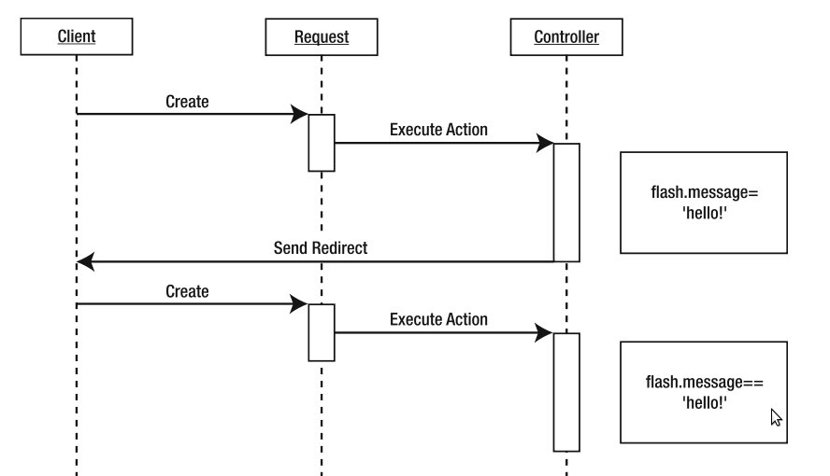
Flash Scope
A special scope which is available for two requests
Useful in the case of a redirect
Notes:
A set of services, APIs and protocols. Multi Tiered web applications.
A Standardized way of doing things. Decreases the need for programming a lot of features which are already available as re-usable components.

Slide 22
Demo

Slide 23
Scoped Controllers
By default, a new controller instance is created for each request
You can change this behaviour by placing a controller in a particular scope.
static scope = "singleton"
Prototype
Session
Singleton
You can define the default strategy under in Config.groovy
grails.controllers.defaultScope = "singleton"

Slide 24
Before Interceptor
The 'before' interceptor intercepts processing before the action is executed.
If it returns 'false' then the following action will not be executed.
def beforeInterceptor = {
println "Tracing action ${actionUri}"
}

Slide 25
Before Interceptor
An action can also be specified to be executed as a before interceptor
def beforeInterceptor = [action: this.&myAction]
def myAction() { println “Hello World!!” }
Also specify that before interceptor be not applied to certain action using the 'except' parameter
Or specify interceptor to be executed for only one action using the 'only' parameter

Slide 26
After Interceptor
afterInterceptor is executed after an action
The after interceptor takes the resulting model as an argument and can hence perform post manipulation of the model or response.
def afterInterceptor = { model ->
println "Tracing action ${actionUri}"
}
def afterInterceptor = { model, modelAndView ->
println "Current view is ${modelAndView.viewName}"
if(model.someVar) modelAndView.viewName = "/mycontroller/someotherview"
println "View is now ${modelAndView.viewName}"
}

Slide 27
After Interceptor
Similar to a before interceptor, an action can also be specified to be executed as an after interceptor
def afterInterceptor = [action: this.&myAction]
private myAction(model) { println “Ghost!!” }
The parameters 'except' and 'only' can also be used in after interceptor

Slide 28
Demo

Slide 29
References
http://grails.org/doc/latest/guide/theWebLayer.html#controllers

Slide 30
Questions??
Notes:
A set of services, APIs and protocols. Multi Tiered web applications.
A Standardized way of doing things. Decreases the need for programming a lot of features which are already available as re-usable components.

Slide 31
Thank You!
Notes:
A set of services, APIs and protocols. Multi Tiered web applications.
A Standardized way of doing things. Decreases the need for programming a lot of features which are already available as re-usable components.

Slide 32
Exercise
Create a LoginController that will handle all login related functionality
Create a login page with basic html
Create a action loginHandler in user controller which sets session user
Create Admin Controller and create an action named "stats" in it
Create a simple view and render the following information: Number of Users and their number of subscriptions
Use Scaffolding to generate controllers and views for all domain classes
Use beforeInterceptor to render "Access Denied" if the user is not admin@intelligrape.com and trying to access the action "stats"

